Slide 1
Survey Research in Software Engineering
Handbook on Teaching Empirical Software Engineering
Authors
Marcos Kalinowski (Pontifical Catholic University of Rio de Janeiro)
Allysson Allex Araújo (Federal University of Cariri)
Daniel Mendez (Blekinge Institute of Technology, fortiss)

Slide 2
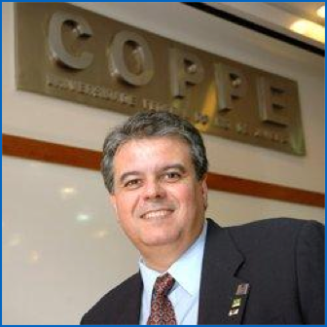
This tutorial is based on…
Previous editions given together with
Experiences made in large survey research projects, e.g.
Marco Torchiano Politecnico di Torino
Rafael M. de Mello PUC Rio de Janeiro
Guilherme H. Travassos COPPE, University of Rio de Janeiro
see www.re-survey.org

Slide 3
Introduction - Who are you?
Quick round…
Who are you?
What are your experiences in conducting survey research?
Are you currently facing any particular challenges?
What are your expectations?

Slide 4
What do you think?
Why do we need survey research in software engineering?

Slide 5
This session will be about
Scope
Brief introduction into survey research and epistemological setting
Experiences and lessons learnt (Best Practices)
Discussion / Hands-on session
Out of scope:
Statistics
(In-depth) Fundamentals
Statistics (this is definitively not about statistics)

Slide 6
Ground rule
Whenever you have questions / remarks,
share them with the whole group.
don’t ask Google , but

Slide 7
Outline
A brief introduction into survey research
(Selected) Best practices
Lean coffee
40’-60’
40’-60’
0’ - 40’

Slide 8
Outline
A brief introduction into survey research
(Selected) Best practices
Lean coffee

Slide 9
What is survey research?
Observational data with limited control
Descriptive and analytic statistics

Slide 10
Observational studies
Surveys
(Cross-sectional)
Case Studies
Experiments
(Case-control)

Slide 11
Epistemological setting (very briefly)
Philosophy of science
Epistemology
Principle ways of working
Empiricism
Controlled Experimentation
Methods and strategies
Hypothesis testing
Fundamental theories
Statistics

Slide 12
Setting: Empirical Software Engineering
Philosophy of science
Principle ways of working
Theory building and evaluation
… are supported by…
Methods and strategies
Methods and strategies
Fundamental theories
Analogy: Theoretical and Experimental Physics

Slide 13
Setting: Empirical Software Engineering
Philosophy of science
Also important (but often neglected)
Principle ways of working
In empirical Software Engineering, we rely on every layer!
Methods and strategies
Fundamental theories

Slide 14
A very quick step into the philosophy of science … and back

Slide 15
Theories and hypotheses
Theory / Theories
Scientific theory
“[…] based on hypotheses tested and verified multiple times by detached researchers” (J. Bortz and N. Döring, 2003)
Theory (Pattern) Building
Hypothesis Building
(Tentative) Hypothesis
Hypothesis
“[…] a statement that proposes a possible explanation to some phenomenon or event” (L. Given, 2008)
Grounded in theory, testable and falsifiable
Often quantified and written as a conditional statement
Falsification / Corroboration
Empiricism
If cause/assumption (independent variables)
then (=>)
consequence (dependent variables)

Slide 16
From real world to theories… and back
Principles, concepts, terms
Theory / Theories
Abduction
(Creative) Synthesis of an explanatory case from a general rule and a particular result (observation)
Theory (Pattern) Building
Hypothesis Building
Induction
Deduction
Inference of a general rule from a particular case/result (observation)
(Tentative) Hypothesis
Application of a general rule to a particular case, inferring a specific result
Falsification / Corroboration
Empiricism
Units of Analysis
Sampling Frame (Population)
Sampling
Real World

Slide 17
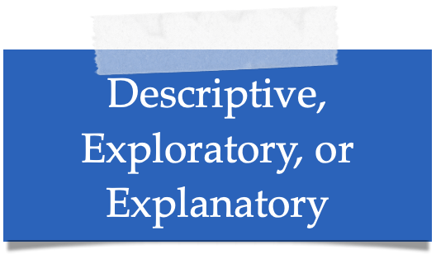
(Empirical) methods
Each method…
…has a specific purpose
…relies on a specific data type
Purposes
Exploratory
Descriptive
Explanatory
Improving
Data Types
Qualitative
Quantitative
(Tentative) Hypothesis
Falsification / Corroboration
Empiricism
Units of Analysis
Sampling Frame (Population)
Sampling
Real World

Slide 18
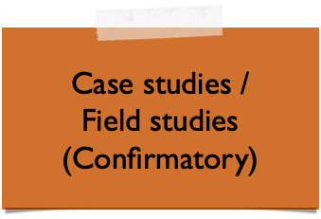
(Empirical) methods - where do they belong?
Theory / Theories
Abduction
Theory (Pattern) Building
Hypothesis Building
Induction
Deduction
(Tentative) Hypothesis
Falsification / Corroboration
Empiricism
Units of Analysis
Sampling Frame (Population)
Sampling
Real World

Slide 19
Survey research in a nutshell
Surveys
allow for observational studies
can have different purposes
rely on both qualitative and qualitative data
can employ different data analysis methods
are (often) used in combination with multiple empirical methods (“research programmes”)

Slide 20
A very simplified process for survey research
* And some examples based on

Slide 21
Survey Planning
Defining Research Objectives
Characterising Target Population
Sampling
Questionnaire Design
Recruiting & Measuring
Survey Execution
Data Coding & Editing
Post-survey Adjustments
Data Analysis & Interpretation
Packaging & Reporting
Data Curation & Disclosure
Reporting
Notes:
Recruitment as bridge to execution

Slide 22
Survey Planning
Defining Research Objectives
Characterising Target Population
Sampling
Questionnaire Design
Recruiting & Measuring
Survey Execution
Data Coding & Editing
Post-survey Adjustments
Data Analysis & Interpretation
Packaging & Reporting
Data Curation & Disclosure
Reporting

Slide 23
Survey Planning
Defining Research Objectives
Scoping overall endeavour via objectives and (research) questions
Basis for:
target population
questionnaire design
Characterising Target Population
Sampling
Questionnaire Design
Recruiting & Measuring
Survey Execution
Objective
Data Coding & Editing
Understand what problems practitioners experience in their Requirements Engineering.
Post-survey Adjustments
Data Analysis & Interpretation
Research Questions
Which contemporary problems exist in RE?
What are observable patterns of problems and context characteristics?
What are their perceived causes and effects?
Packaging & Reporting
Data Curation & Disclosure
Reporting

Slide 24
Survey Planning
Defining Research Objectives
Target population: abstract definition of set of units to be studied
Frame population: All units in the (envisioned) sampling frame
Sample: Actual set of (eligible) future respondents
Characterising Target Population
Sampling
Questionnaire Design
Recruiting & Measuring
Survey Execution
Target Population
Data Coding & Editing
Practitioners working with requirements:
Requirements Engineers
Software Architects
…
in domain X and region Y
Post-survey Adjustments
Data Analysis & Interpretation
Frame Population
Packaging & Reporting
Requirements Engineers in domain X and region Y, registered in association Z
…
Data Curation & Disclosure
Sample
Reporting
[Role] working with requirements for [x] years
…

Slide 25
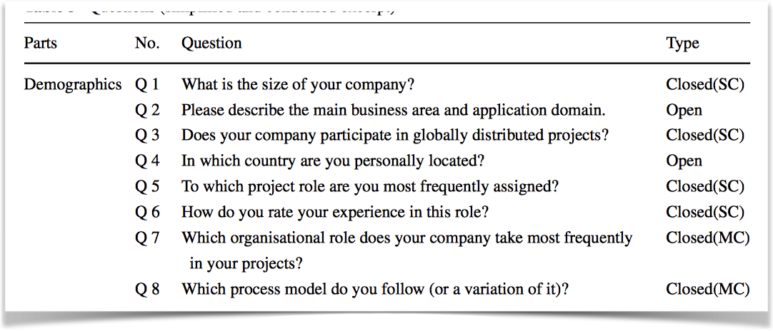
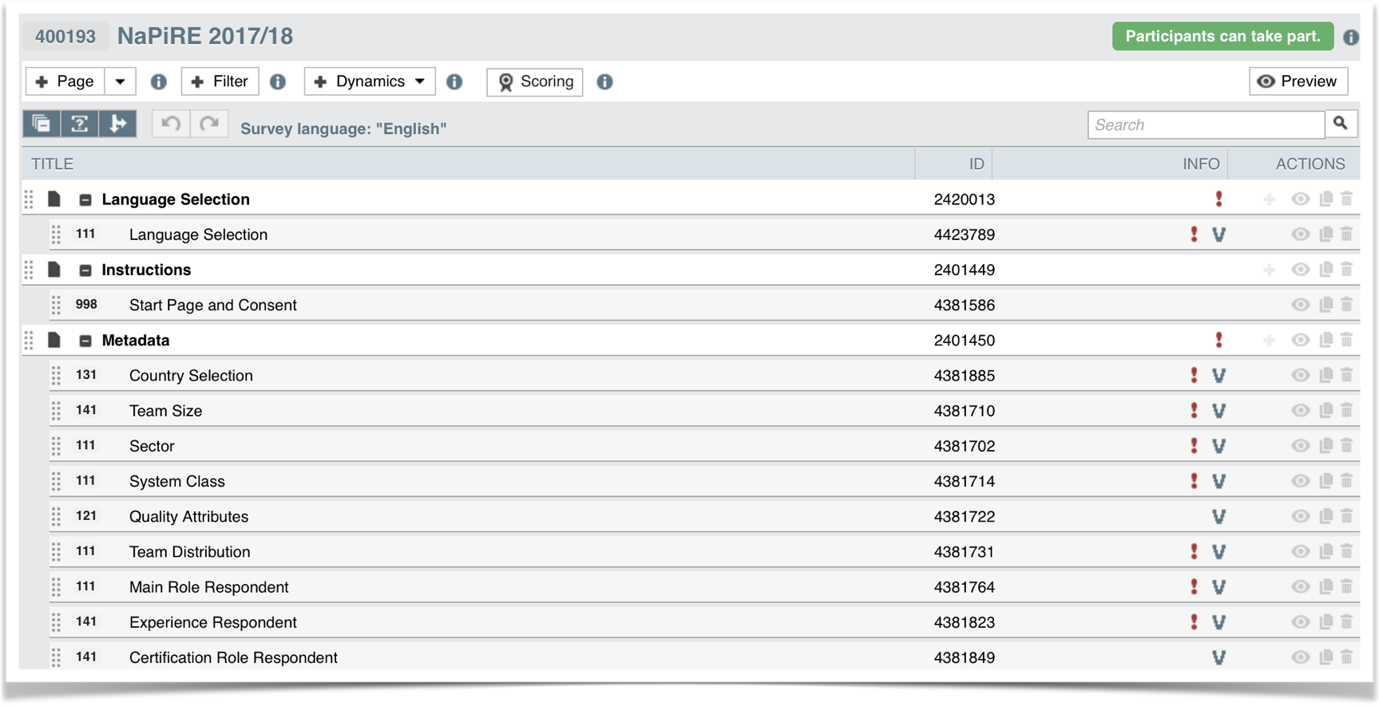
Survey Planning
Defining Research Objectives
Design of questionnaire used to answer the research questions
Implementation / Realisation
Characterising Target Population
Sampling
Questionnaire Design
Recruiting & Measuring
Survey Execution
Data Coding & Editing
Post-survey Adjustments
Data Analysis & Interpretation
Packaging & Reporting
Data Curation & Disclosure
Reporting

Slide 26
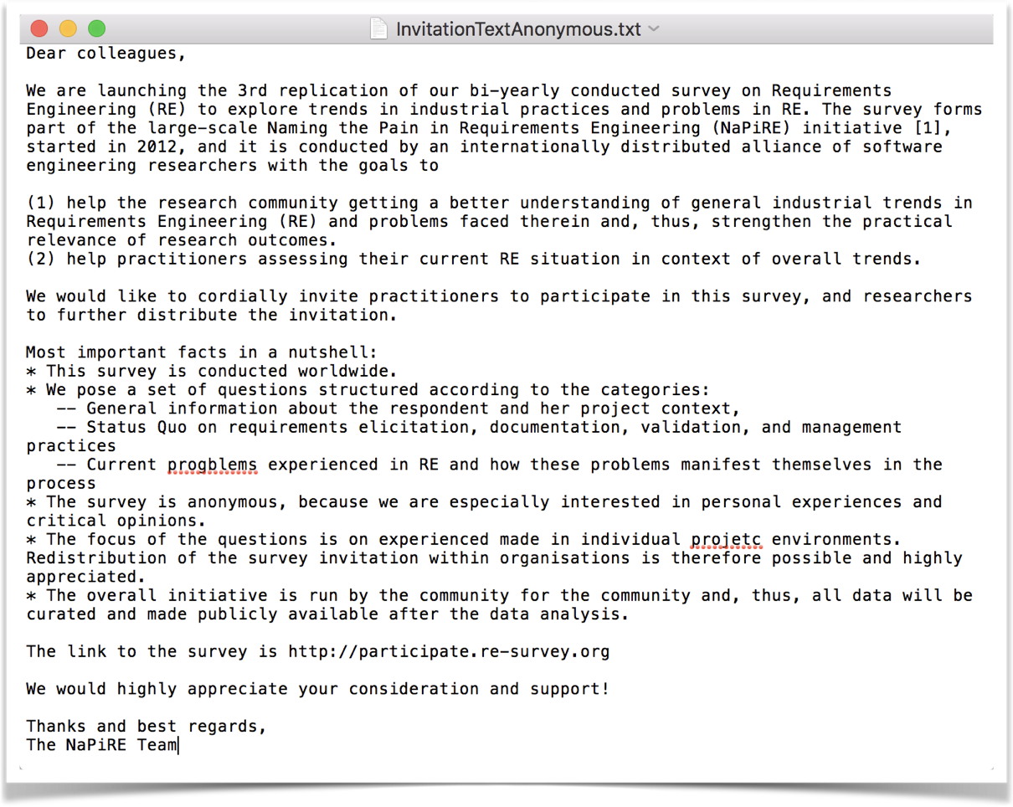
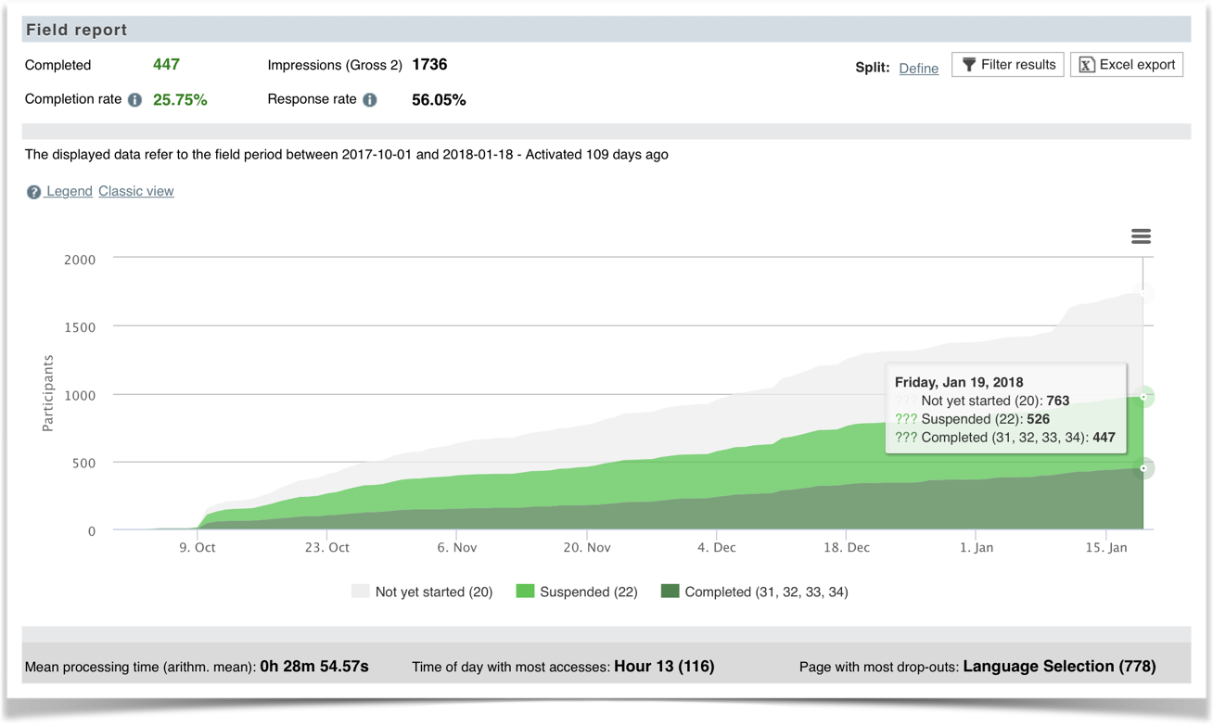
Survey Planning
Defining Research Objectives
Actual data collection conducted through the survey
Respondents invitation
Continuous Control
Characterising Target Population
Sampling
Questionnaire Design
Recruiting & Measuring
Survey Execution
Data Coding & Editing
Post-survey Adjustments
Data Analysis & Interpretation
Packaging & Reporting
Data Curation & Disclosure
Reporting

Slide 27
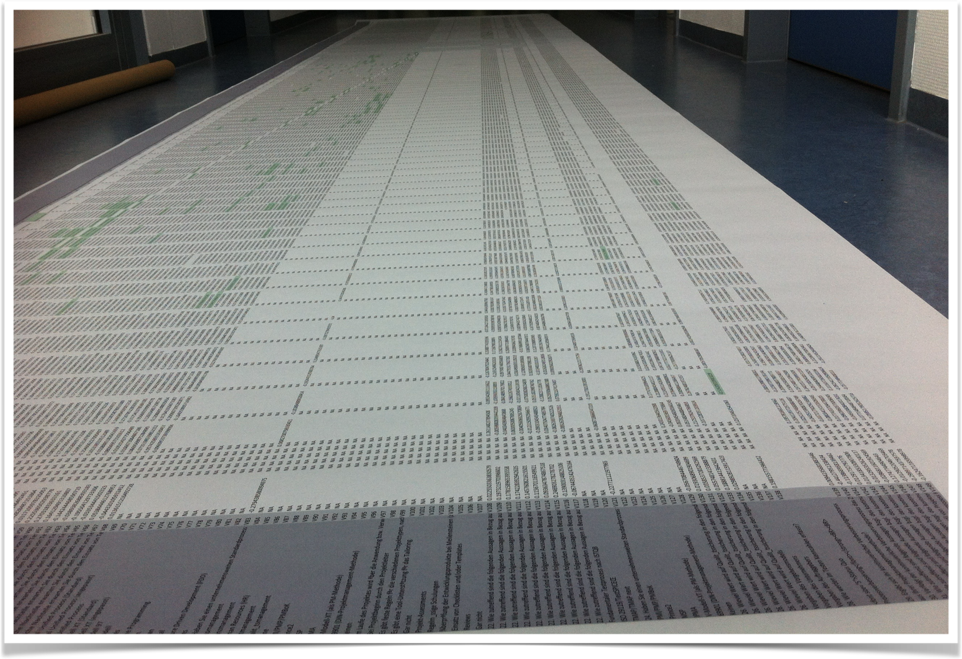
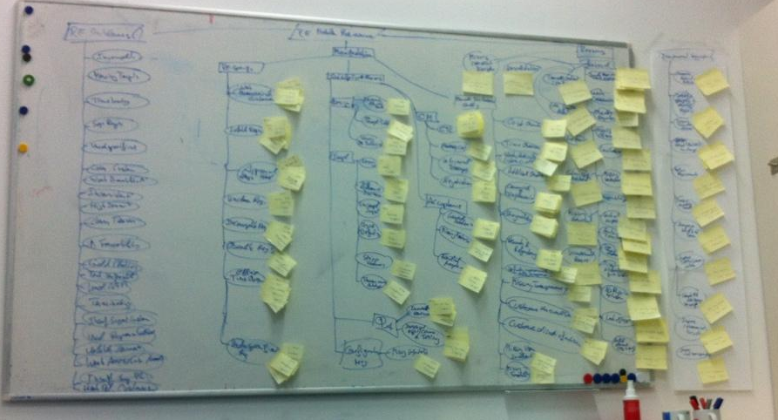
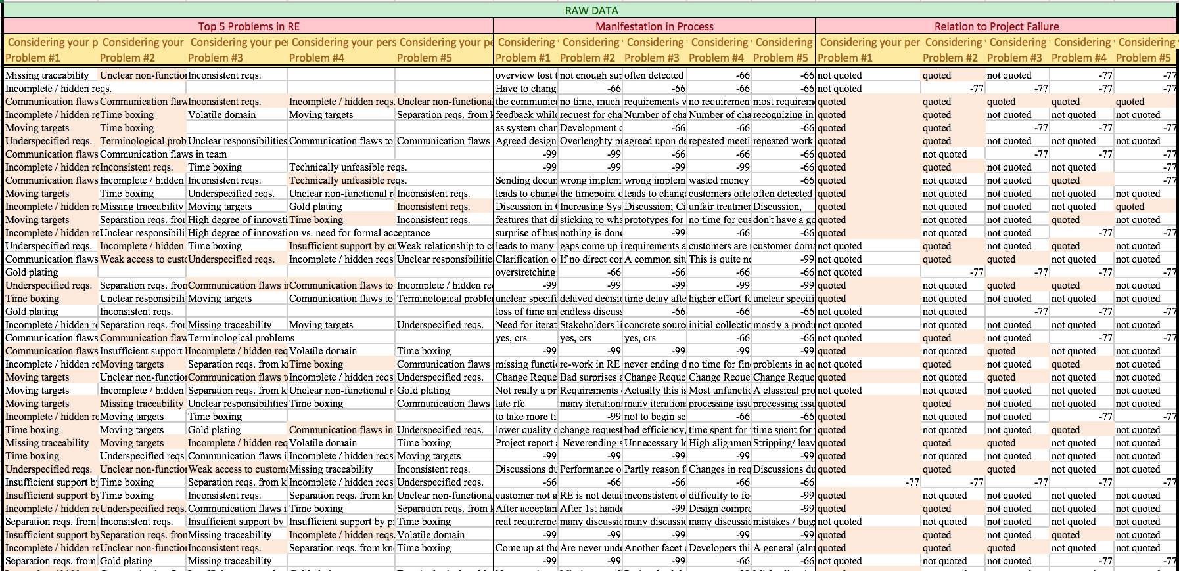
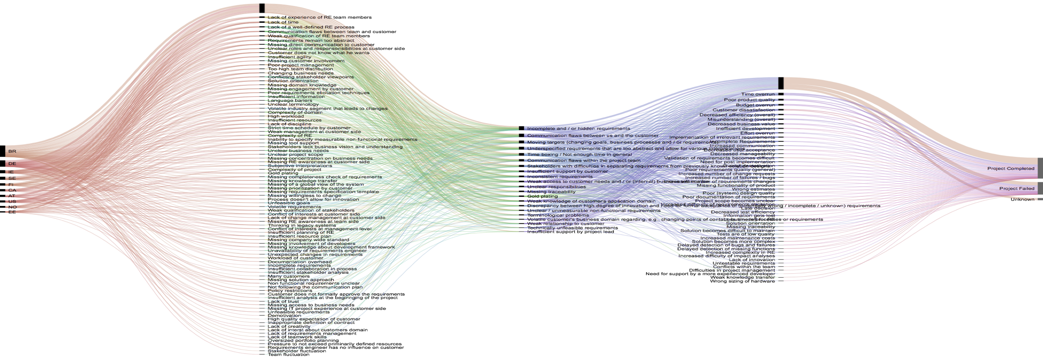
Survey Planning
Defining Research Objectives
Data coding & editing: Review process before using data and harmonisation (e.g. consistency checks, outlier detection)
Post-survey Adjustments based on actual responses
Analysis of quantitative and qualitative data
Characterising Target Population
Sampling
Questionnaire Design
Recruiting & Measuring
Survey Execution
Data Coding & Editing
Post-survey Adjustments
Data Analysis & Interpretation
Packaging & Reporting
Data Curation & Disclosure
Reporting

Slide 28
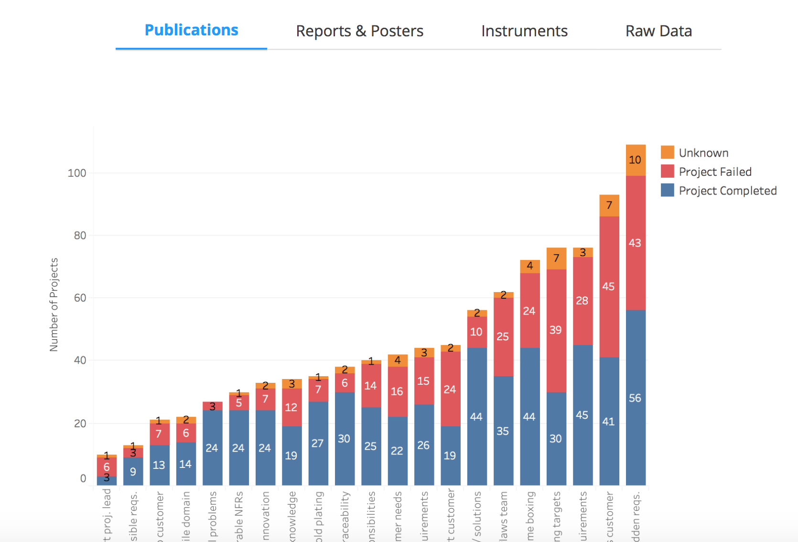
Survey Planning
Defining Research Objectives
Data curation and disclosure: Preparation of data for reproducible disclosure (e.g. anonymisation, codebooks)
Reporting
To respondents (e.g. via technical reports, blog posts)
Paper writing (very different audience)
Characterising Target Population
Sampling
Questionnaire Design
Recruiting & Measuring
Survey Execution
Data Coding & Editing
Post-survey Adjustments
Data Analysis & Interpretation
Packaging & Reporting
Data Curation & Disclosure
Reporting

Slide 29
Questions?

Slide 30
Outline
A brief introduction into survey research
(Selected) Best practices
Lean coffee

Slide 31
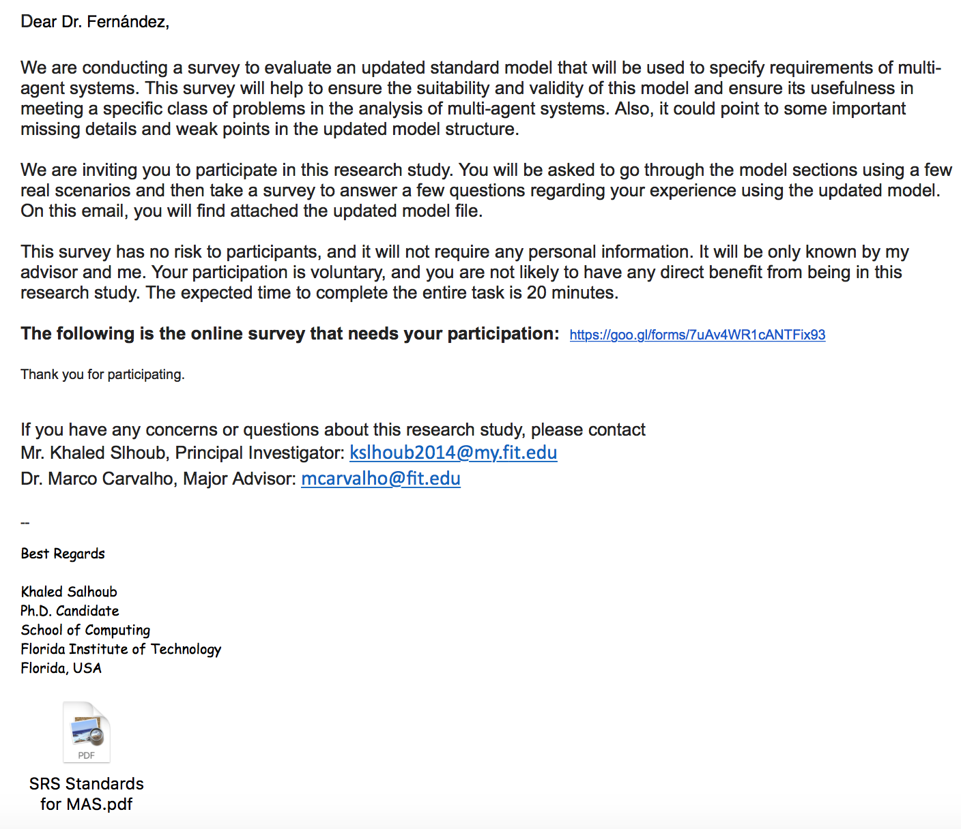
Example - What could be wrong here?
Who are they?
17 pages attachment to read…
20 minutes to answer the survey…

Slide 32
Disclaimer

Slide 33
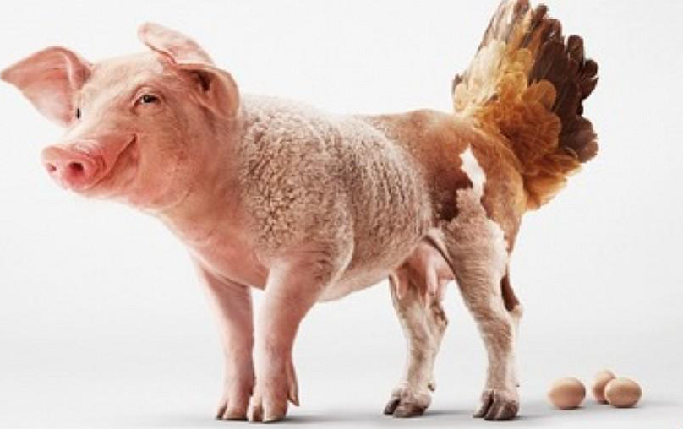
Disclaimer (Bavarian edition)

Slide 34
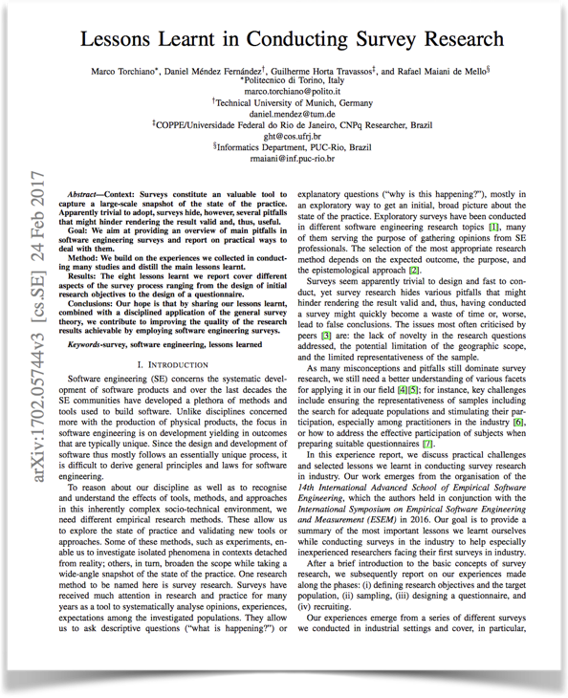
Survey Planning
Defining Research Objectives
There are too many pitfalls to be handled in a short tutorial.
Recommended reading:
Torchiano, M., Méndez Fernández, D., Travassos, G.H., de Mello, R. M. (2017). Lessons Learnt in Conducting Survey Research. In: Proc. 5th International Workshop on Conducting Empirical Studies in Industry (CESI). ICSE 2017. Available at https://arxiv.org/abs/1702.05744
Characterising Target Population
Sampling
Questionnaire Design
Recruiting & Measuring
Survey Execution
Data Coding & Editing
Post-survey Adjustments
Data Analysis & Interpretation
Packaging & Reporting
Data Curation & Disclosure
Reporting

Slide 35
Survey Planning
Defining Research Objectives
Characterising Target Population
Sampling
Questionnaire Design
Recruiting & Measuring
Survey Execution
We concentrate on 4 issues, instead
(I personally find highly important)
Data Coding & Editing
Post-survey Adjustments
Data Analysis & Interpretation
Packaging & Reporting
Data Curation & Disclosure
Reporting

Slide 36
Defining research objectives
Challenge Know the limitations of survey research
Survey research opts for answers that rely on experiences, opinions, and observations (folklore) of the respondents
Respondents’ bias is our natural environment
Develop internal questions to help you depict the research objective and target population
Opt for descriptive questions (“what is happening?”) or explanatory questions (“why is this happening?”) rather than normative questions (“what should we do?”)

Slide 37
Characterising the target population
Challenge Identify the real target population
Do not restrict the target population by factors like availability or expected number of responses!
Based on the research objectives, answer the question: “Who can best provide you with the information you need?”, not “Who are probably available to participate?"

Slide 38
Characterising the target population
Challenge Identify the units of analysis (1/2)
Individuals? Groups? Teams? Companies?
For instance, investigating Java developers’ programming practice is a research objective different from investigating Company practice for Java programming

Slide 39
Characterising the target population
Challenge Identify the units of analysis (2/2)
“How do developers perform code debugging?”
“How is code debugging performed in companies?”
List of developers
List of companies
Units of Analysis
Units of Analysis

Slide 40
Characterising the target population
Challenge Characterise the subjects and units of analysis
Different research objectives may demand different attributes to characterising individuals/ groups of individuals
Use standard reference models (e.g. in context of process tailoring):
Individuals: experience in the research context, experience in SE, current professional role, location and higher academic degree, …
Project teams: team size, client/product domain (avionics, finance, health, telecommunications, etc.) and physical distribution, …
Organisations: size, industry segment, location, type (government, private company, university, etc.), …

Slide 41
Questionnaire design
Challenge Design a clear, simple and consistent survey questionnaire
Bad questionnaires can lead subjects initially willing to participate to give up!
Use simple and appropriate wording for the survey questions
Avoid vague sentences
Avoid technical terms as much as possible or define them in the questionnaire, according to the survey target population
Take preference to design short questions regarding a single concept
Avoid double barreled questions

Slide 42
Questionnaire design
Challenge Design a clear, simple and consistent survey questionnaire

Slide 43
Questionnaire design
Challenge Design a clear, simple and consistent survey questionnaire
Avoid biased questions
Avoid asking about events too far in the past

Slide 44
Questionnaire design
Challenge Design a clear, simple and consistent survey questionnaire
Avoid asking sensitive questions unless you really need to (and if you need to, make explicit why you ask these questions)

Slide 45
Questionnaire design
Challenge Design a clear, simple and consistent survey questionnaire
Avoid asking too demanding questions (w.r.t. time, effort)

Slide 46
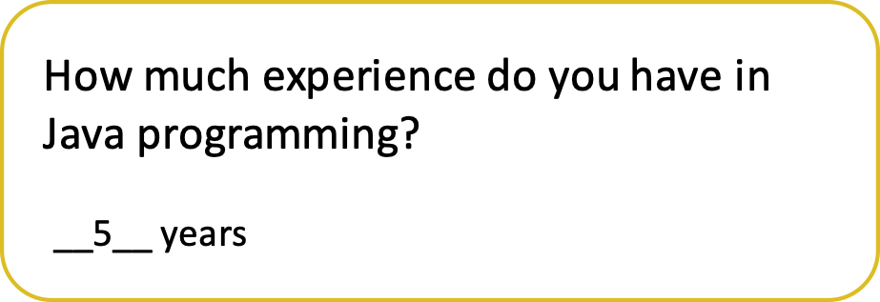
Questionnaire design
Challenge Design a clear, simple and consistent survey questionnaire
Select the appropriate response formats and scales

Slide 47
Response formats and scales
 | Nominal scale | Ordinal (and “Likert”) scales | Interval scale | Free-text responses | Numeric values
Characteristic | Closed questions | Closed questions Not always equally distributed No distance measure | Closed questions Considered equally distributed | Open questions Allow “coding” | Open questions
Analysis | Statistical analysis based on frequency | Significantly restricts statistical analysis | Statistical analysis less restrictive | Content analysis High effort on data analysis | Allow a wide range of statistical analysis

Slide 48
Questionnaire design
Remember: you have one shot only! (Once you started the survey, there is usually no way back.)
Pilot the survey instrument with respondents characteristic for your population!
Pilot the data (quantity and quality) by applying the planned data analysis techniques!
Challenge Design a clear, simple and consistent survey questionnaire

Slide 49
Data curation and disclosure
Challenge A survey needs to be reproducible
Reporting on a survey without background information is asking for too much credit from the reader (and the reviewers)!
Report on details of all data collection with a study protocol
Disclose the instrument used: Questionnaire, reference documents
Disclose the anonymised data and the codebooks
Do not use your institution websites (prone to changes)
Instead, use open repositories like Figshare (providing DOIs)

Slide 50
Besides all methodological issues…
there is more.

Slide 51
Every survey needs a proper project plan
Plan for methodological challenges (✔️)
Find a proper project organisation early
Set up a proper project infrastructure
Develop a good project dissemination plan
Organise an efficient data collection
Organise an efficient data curation and analysis
Develop a good packaging and reporting plan

Slide 52
Are there any particular best practices you would like to share?

Slide 53
Further reading
Torchiano, M., Méndez Fernández, D., Travassos, G.H., de Mello, R. M. (2017). Lessons Learnt in Conducting Survey Research. In: Proc. 5th International Workshop on Conducting Empirical Studies in Industry (CESI). ICSE 2017. Available at https://arxiv.org/abs/1702.05744
Groves, Fowler, Couper, Lepkowski, Singer and Torangeau, (2009). “Survey Methodology – 2nd edition” John Wiley and Sons
Conradi R., Li J., Slyngstad O. P. N., Kampenes V. B., Bunse C., Morisio M., Torchiano M. (2005). “Reflections on conducting an international survey of CBSE in ICT industry” IEEE 4th International Symposium on Empirical Software Engineering November.
Linåker, J. Sulaman, S. M., de Mello, R. M. and Höst, M. (2015). Guidelines for Conducting Surveys in Software Engineering. TR 5366801, Lund University Publications. http://lup.lub.lu.se/record/5366801/file/5366839.pdf
de Mello, R. M. and Travassos, G. H. (2016). Surveys in Software Engineering: Identifying Representative Samples. Proc. of 10th ACM/IEEE ESEM, Ciudad Real.

Slide 54
Outline
A brief introduction into survey research
(Selected) Best practices
Lean coffee

Slide 55
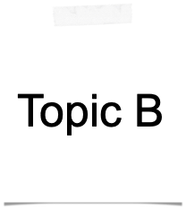
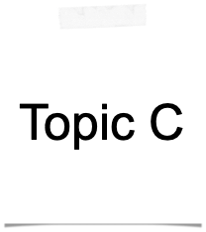
Lean Coffee
1. Collect topics
2. Rank by interest
3. Discuss topics in the group
4. Revise (Continue with B or move on to A?)
!
→
✔️

Slide 56
Break-out session
Plan B
Collect topics / research objectives
Team assignment
Tool introduction
Onboarding (by me)
Work independently on your survey (I’ll be around)
Distribute survey among conference audience

Slide 57
3 Survey tools (proposal)
https://www.typeform.com
https://www.unipark.com/en/
Easy and fast
Limited response types
Free
Similar to google forms, but also with easy
Pipelining
Conditional questions
Free version (100 responses/10 fields)
Heavy-weight
Nearly anything (but scripting is elaborate)
Free test version (2 weeks)

Slide 58
Thanks for your participation!
In case of questions, approach me any time!

